Slide 1


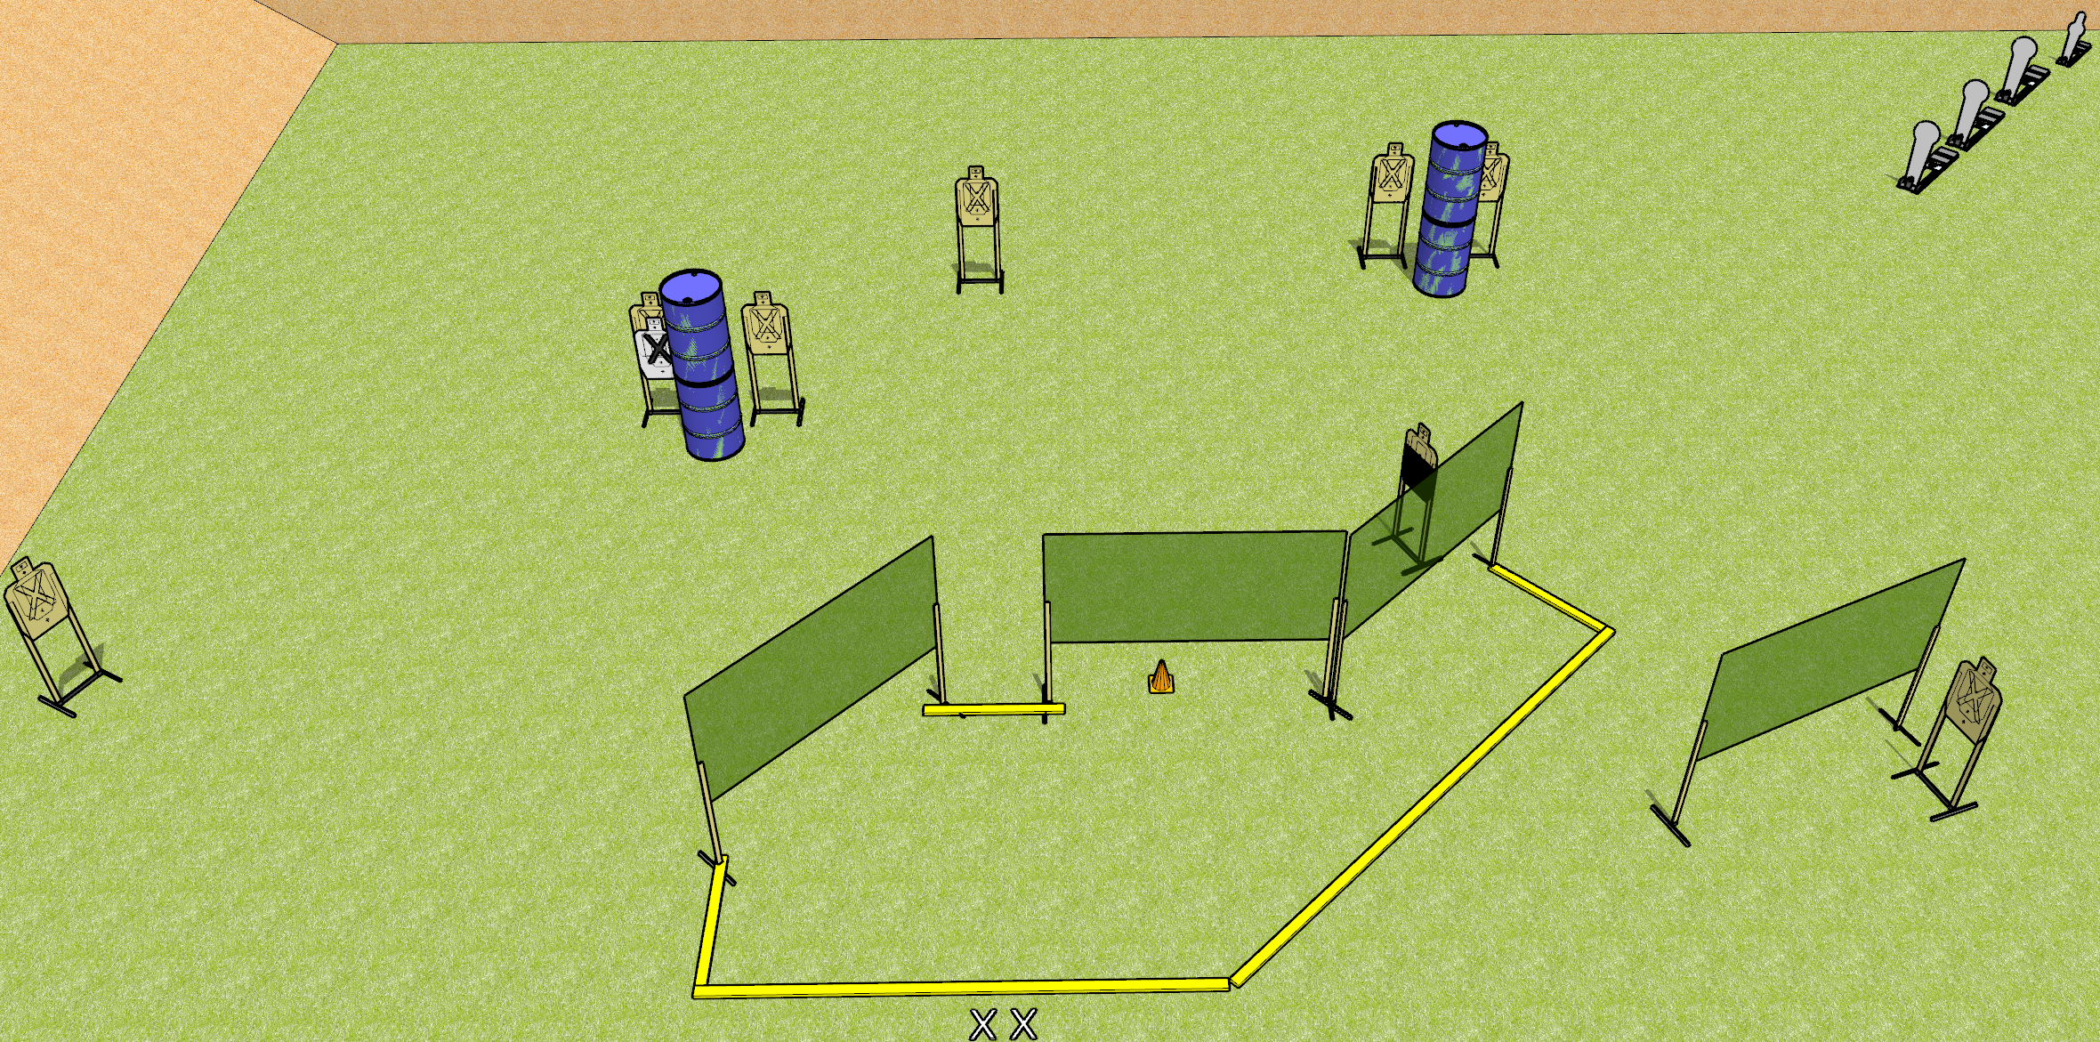
 | Dothan Gun Club – USPSA Match Conga Line Course Designer : Drew Coleman
START POSITION : Standing with both feet on X’s, wrists below belt
GUN READY CONDITION : Pistol loaded and holstered. PCC loaded, shouldered, safety on, pointed at orange cone. |  | SCORING: Comstock, 20 rounds TARGETS: 8 paper, 4 Steel SCORED HITS: Best 2 on paper, steel until down START-STOP: Audible, last shot RULES:
STAGE PROCEDURE: Engage targets as they become available from within the fault lines.

Slide 2
Stage Name
Written Stage Briefing
Conga Line is a 20 round, 100 point, Comstock Medium Course. There are eight USPSA targets, three Colt Poppers, and one mini popper. The best two hits on paper will score, and steel must fall to score. The start signal is audible.
Handgun start position is standing with both feet touching X’s outside the shooting area, wrists below belt. Handgun is loaded and holstered.
PCC start position is standing with both feet touching X’s outside the shooting area. Carbine is loaded, held with both hands, safety on, shouldered, pointed at orange cone.
Upon start signal engage targets as they become available from within the shooting area.

